Slide 1

PLANNING IN LAPEL Processes for Updating the UDO
December 2025
Prepared by: Marcellus Johnson

Slide 2
Contents
Elements of Zoning Ordinances
Processes for Changing Zoning
Zoning Map Amendments (Rezoning)
Zoning Text Amendments
Zoning Ordinance Replacement
References

Slide 3
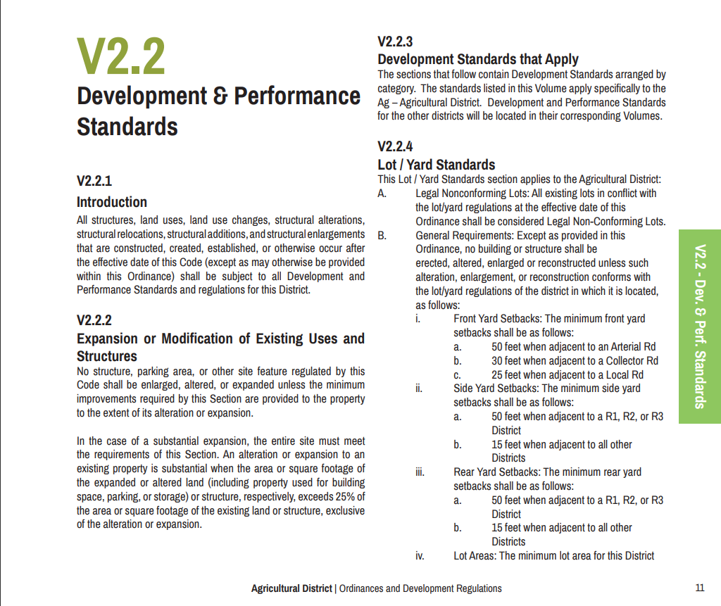
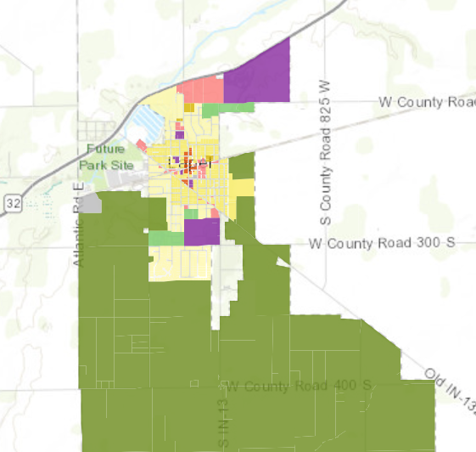
Elements of a Zoning Ordinance
Zoning Text
Zoning Map

Slide 4
Processes for Changing Zoning
Map Amendment
Text Amendment
Ordinance Replacement
Notes:
Map amendment = rezoning; text amendment may be change of text or partial repeal (repeal of sections/subsections/paragraphs)

Slide 5
Zoning Map Amendments (Rezoning)
Governed by V 1.8.6 (consistent with IC 36-7-4-602)
Initiated by Plan Commission, Town Council, or by Petition
Public Hearing held by Plan Commission within 60 days of application
Notice of Public Hearing in Newspaper and by Mail at least 10 days before hearing
Plan Commission forwards favorable, unfavorable, or no recommendation to Town Council (or may continue/table)

Slide 6
Zoning Map Amendments (Rezoning) Cont.
Public Hearing held by Town Council within 90 days of PC certification
Council may approve or deny the amendment
If the Council fails to act on the PC’s favorable recommendation within 90 days, the amendment passes
The petitioner may propose written commitments as part of their application, in response to comments made at PC hearing, or in response to changes requested by the PC
Council may modify, add, or delete written commitments, but the new commitments must be reviewed and affirmed by the PC

Slide 7
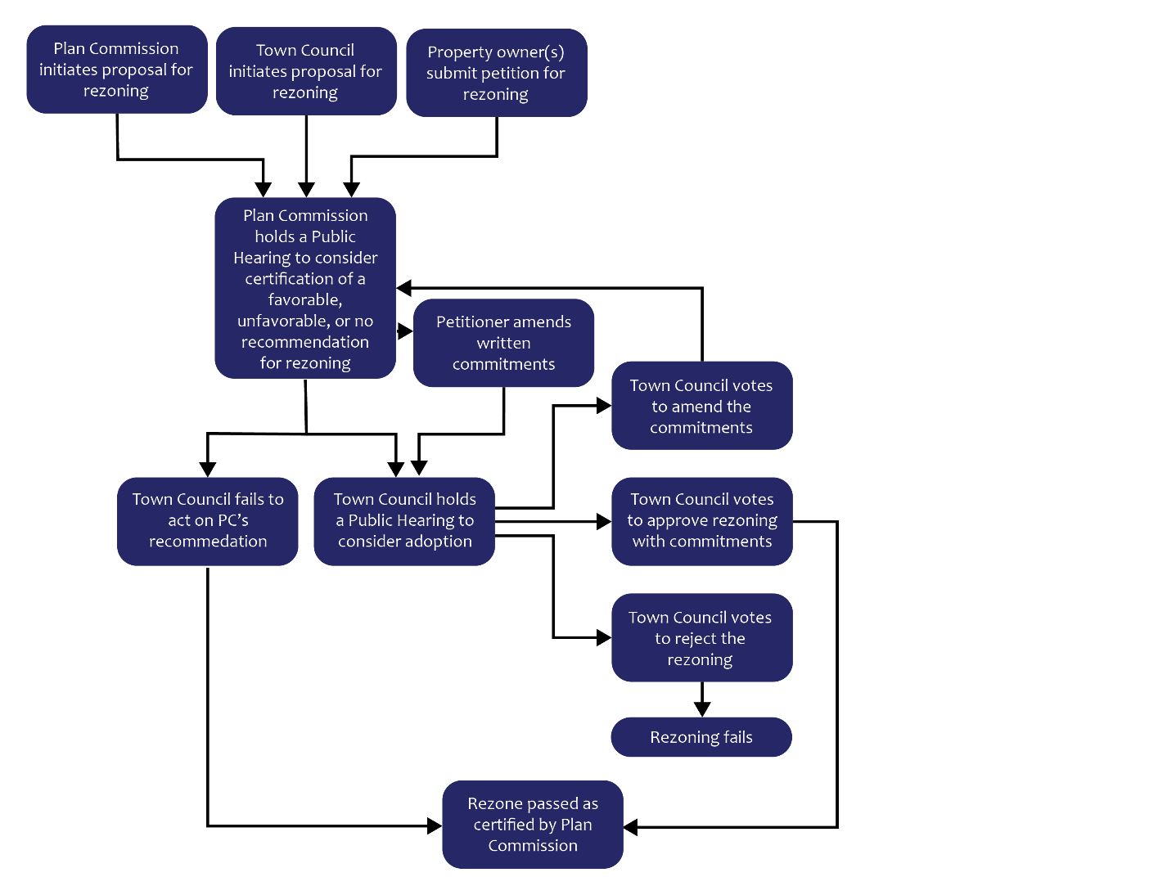
Zoning Map Amendments (Rezoning) Flowchart

Slide 8
Zoning Text Amendment
Governed by IC 36-7-4-602 (by reference V 1.2.12)
Proposal may be initiated by Plan Commission or Town Council
Public Hearing held by Plan Commission within 60 days initiation of proposal
Notice in Newspaper at least 10 days before hearing (PC may adopt rules determining requirements for notice to “interested parties”)
Plan Commission forwards favorable, unfavorable, or no recommendation to Town Council (or may continue/table)

Slide 9
Zoning Text Amendment Cont.
Town Council shall vote within 90 days of PC certification
Town Council may adopt, reject, or amend the proposal
If the Council fails to act on the PC’s favorable recommendation within 90 days, the proposal passes
If the Council rejects or amends the proposal the decision is referred back to PC with written statement of reasons

Slide 10
Zoning Text Amendment Cont.
Plan Commission has 45 days to consider the rejection or amendment
If PC approves or fails to act within 45 days, the Town Council’s decision stands
If PC disapproves of Council’s decision, then Council has 45 days to vote again to affirm its decision
If the Council fails to affirm its decision, then the version certified by PC passes

Slide 11
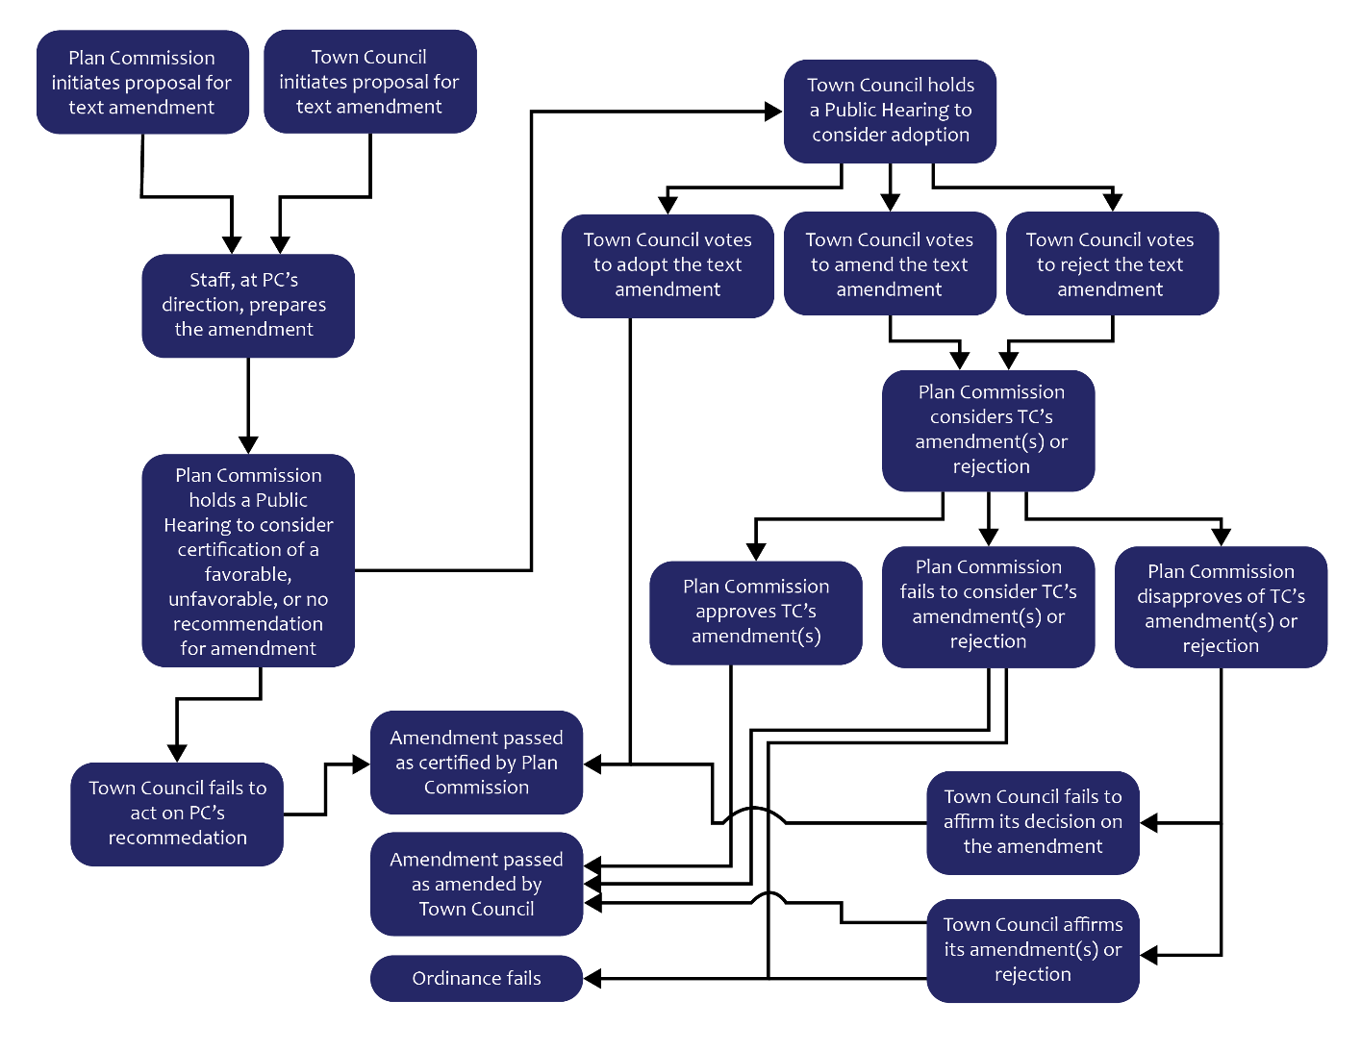
Zoning Text Amendment Flowchart

Slide 12
Zoning Ordinance Replacement
Governed by IC 36-7-4-602
Proposal must be initiated by Plan Commission
Staff prepares the replacement ordinance – text and map
Notice in Newspaper at least 10 days before hearing (PC may adopt rules determining requirements for notice to “interested parties”)
Plan Commission forwards favorable recommendation to Town Council (or may continue/table)

Slide 13
Zoning Ordinance Replacement Cont.
At first meeting following PC certification, Town Council shall either act on the certification or decide to schedule it for another meeting within 90 days of certification
If Council decides to consider the proposal at a later meeting, notice must be published in Newspaper at least 10 days before the meeting
Town Council may adopt, reject, or amend the proposal
If the Council fails to act on the PC’s favorable recommendation within 90 days, the proposal passes
If the Council rejects or amends the proposal the decision is referred back to PC with written statement of reasons

Slide 14
Zoning Ordinance Replacement Cont.
Plan Commission has 45 days to consider the rejection or amendment
If PC approves or fails to act within 45 days, the ordinance stands as passed by Council as of the date of filing of PC approval or at the end of the 45-day period
If PC disapproves of Council’s decision, then Council has 45 days to vote again to affirm its decision
If the Council fails to affirm its decision, then the version certified by PC passes
If the Council affirms its decision, then the decision stands

Slide 15
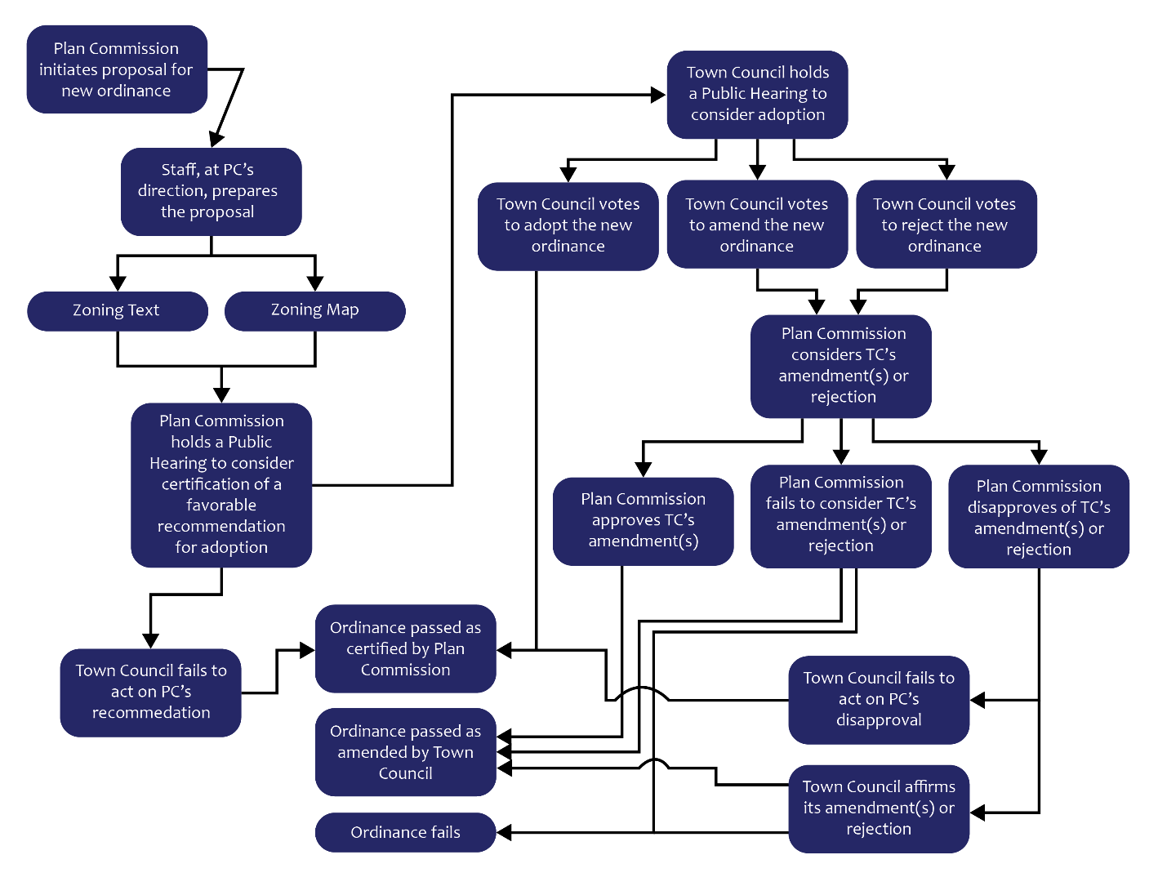
Zoning Ordinance Replacement Flowchart

Slide 16
References
Lapel UDO Volume 1
IC 36-7-4-602

